Slide 1
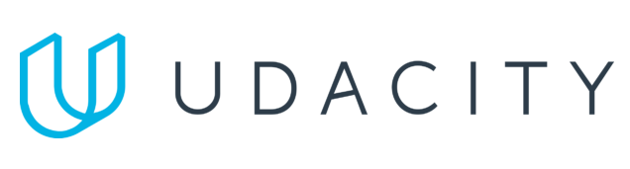
Data Lake Value Proposition
Medical Data Processing Company
MALEINA BIDEK
Udacity IPS Version 1.0

Slide 2
Agenda
What is a Data Lake
Components of a Data Lake
Data Lake vs Data Warehouse
Business Value of Data Lake Solution
Proposed Data Lake Architecture for Medical Data Processing system
Udacity IPS Ver. 1 2/2020

Slide 3
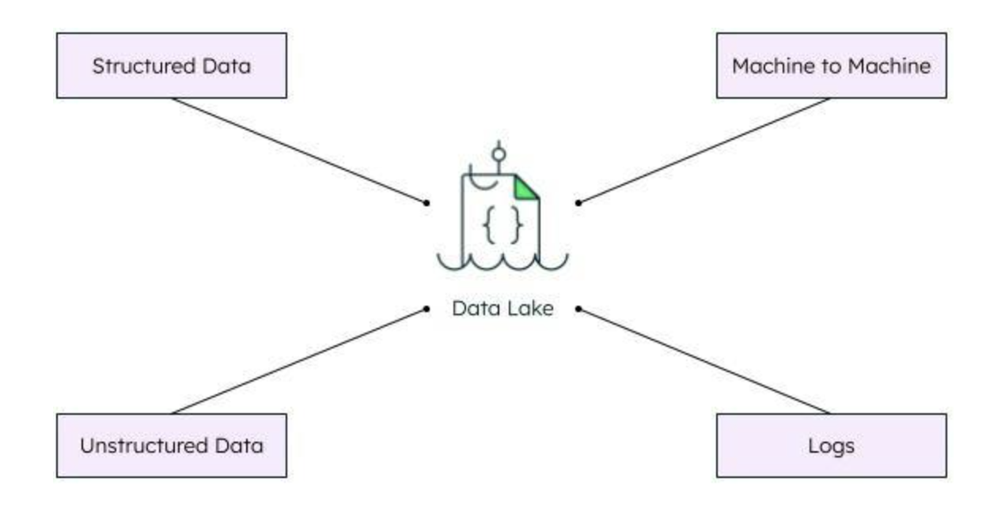
What is a Data Lake
Executive summary
Centralized place to store data in its native format.
Data can be structured, semi-structured, or unstructured.
Breaks data silos within an organization so that data can be used for real-time analytics and machine learning.
Diagram source: MongoDB

Slide 4
Components of Data Lake
Ingestion Layer: How data is added to the data lake from various sources (data streaming, file transfers, etc.)
Storage Layer: How and where data is physically stored. Also includes the production of metadata and formating of data for use in the next layer.
Processing Layer: Where the queries are run, often in parallel on smaller sets or chunks of the data (for faster processing)
Serving Layer: Enables the presentation of the data to end users via the use of tools such as dashboards and analytics software or via ad-hoc queries.

Slide 5
Data Warehouse
Data Lake
Data Lake vs Data Warehouse
Data is structured or semi-structured
Schema-on-write
Fixed configuration, difficult to modify
More complex to add new data sources
Mainly proprietary, commercial tools
Higher data storage costs vs. data lake
Data can be structured, semi-structured or unstructured
Schema-on-read
Easier to reconfigure if needs change
Easier to add new data sources and scale up
Can use open-source tools
Lower data storage costs
Udacity IPS Ver. 1 2/2020

Slide 6
Business Value of Data Lake
Our facility data is in various formats, including unstructured file data.
Meta-data driven, no need for custom scripts.
Easier and faster to ingest and process new data sources
Processing on the fly
Speed of innovation, ability to experiment with new frameworks
Ability to scale up
Reduced latency
Improved uptime
Open-source tools
Avoid vendor lock-in
Lower long term costs

Slide 7
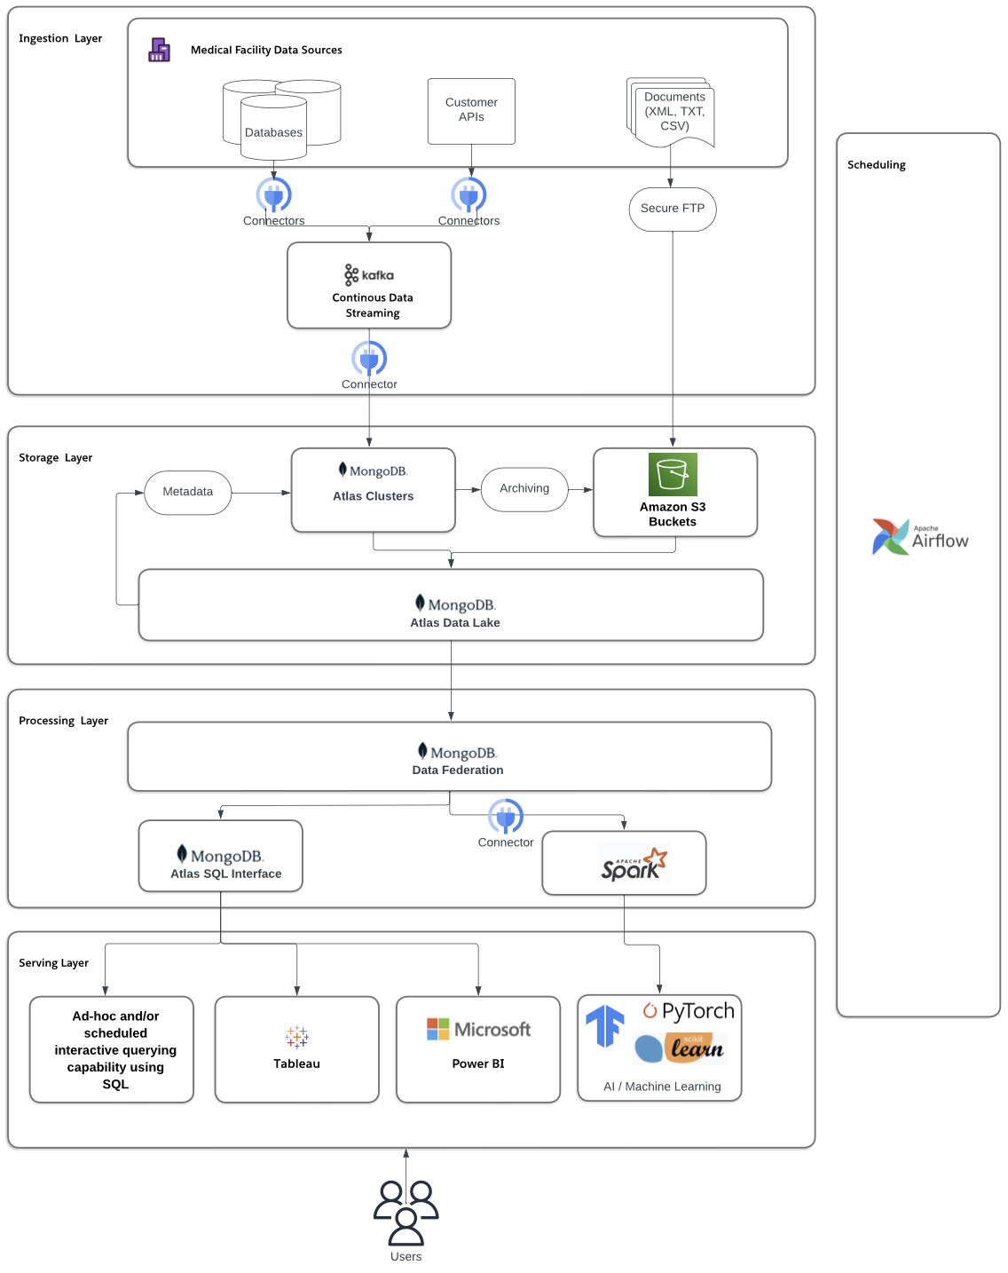
Data Lake Architecture

Slide 8
THANK YOU
Udacity IPS Version 1.0

